Slide 1
Identifiying Other Requirements
It is not sufficient to write use cases. There are other kinds of requirements that need to be identified, such as documentation, packaging, supportability, licensing, and so forth. These are captured in the Supplementary Specification.
The Glossary captures terms and definitions; it can also play the role of a data dictionary.
The Vision summarizes the "vision" of the project. It serves to tersely communicate the big ideas regarding why the project was proposed, what the problems are, who the stakeholders are, what they need, and what the proposed solution looks like.

Slide 2
NextGen Example: (Partial) Supplementary Specification
Introduction
This document is the repository of all NextGen POS requirements not captured in the use cases.
Functionality
(Functionality common across many use cases)
Logging and Error Handling
Log all errors to persistent storage.
Pluggable Business Rules
At various scenario points of several use cases (to be defined) support the ability to customize the functionality of the system with a set of arbitrary rules that execute at that point or event.
Security
All usage requires user authentication.

Slide 3
Usability
Human Factors
The customer will be able to see a large-monitor display of the POS.Therefore:
. Text should be easily visible from 1 meter.
. Avoid colors associated with common forms of color blindness.
Speed, ease, and error-free processing are paramount in sales processing, as the buyer wishes to leave quickly, or they perceive the purchasing experience (and seller) as less positive.
The cashier is often looking at the customer or items, not the computer display. Therefore, signals and warnings should be conveyed with sound rather than only via graphics.
Reliability
Recoverability
If there is failure to use external services (payment authorizer, accounting system, ...) try to solve with a local solution (e.g., store and forward) in order to still complete a sale. Much more analysis is needed here...
Performance
As mentioned under human factors, buyers want to complete sales processing very quickly. One potential bottleneck is external payment authorization. Our goal is to achieve authorization in less than 1 minute, 90% of the time.

Slide 4
Supportability
Adaptability
Different customers of the NextGen POS have unique business rule and processing needs while processing a sale. Therefore, at several defined points in the scenario (for example, when a new sale is initiated, when a new line item is added) pluggable business rule will be enabled.
Configurability
Different customers desire varying network configurations for their POS systems, such as thick versus thin clients, two-tier versus N-tier physical layers, and so forth. In addition, they desire the ability to modify these configurations, to reflect their changing business and performance needs. Therefore, the system will be somewhat configurable to reflect these needs. Much more analysis is needed in this area to discover the areas and degree of flexibility, and the effort to achieve it.
Implementation Constraints
NextGen leadership insists on a Java technologies solution, predicting this will improve long-term porting and supportability, in addition to ease of development.
Purchased Components
.Tax calculator. Must support pluggable calculators for different countries.

Slide 5
Interfaces
Noteworthy Hardware and Interfaces
. Touch screen monitor (this is perceived by operating systems as a regular monitor, and the touch gestures as mouse events)
. Barcode laser scanner (these normally attach to a special keyboard, and the scanned input is perceived in software as keystrokes)
. Receipt printer
. Credit/debit card reader
. Signature reader (but not in release 1)
Software Interfaces
For most external collaborating systems (tax calculator, accounting, inventory, ...) we need to be able to plug in varying systems and thus varying interfaces.

Slide 6
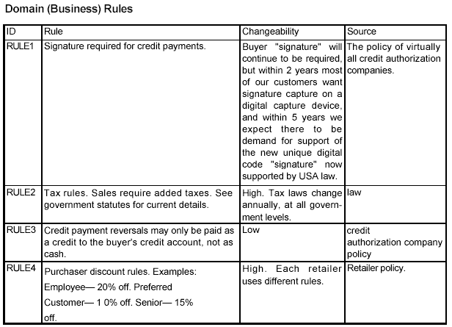

Slide 7
NextGen Example: (Partial) Vision
Introduction
We envision a next generation fault-tolerant point-of-sale (POS) application, NextGen POS, with the flexibility to support varying customer business rules, multiple terminal and user interface mechanisms, and integration with multiple third-party supporting systems.
Positioning
Business Opportunity
Existing POS products are not adaptable to the customer's business, in terms of varying business rules and varying network designs (for example, thin client or not; 2, 3, or 4 tier architectures). In addition, they do not scale well as terminals and business increase. And, none can work in either on-line or off-line mode, dynamically adapting depending on failures. None easily integrate with many third-party systems. None allow for new terminal technologies such as mobile PDAs. There is marketplace dissatisfaction with this inflexible state of affairs, and demand for a POS that rectifies this.
Problem Statement
Traditional POS systems are inflexible, fault intolerant, and difficult to integrate with third-party systems. This leads to problems in timely sales processing, instituting improved processes that don't match the software, and accurate and timely accounting and inventory data to support measurement and planning, among other concerns. This affects cashiers, store managers, system administrators, and corporate management.
Product Position Statement
.Terse summary of who the system is for, its outstanding features, and what differentiates it from
the competition.
Alternatives and Competition...

Slide 8
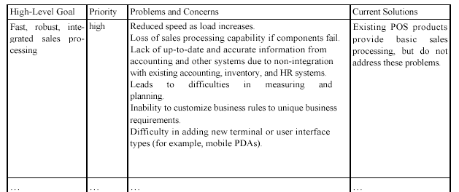
Stakeholder Descriptions
Market Demographics...
Stakeholder (Non-User) Summary... User Summary...
Key High-Level Goals and Problems of the Stakeholders

Slide 9
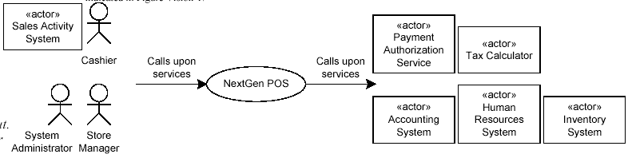
User-Level Goals
The users (and external systems) need a system to fulfill these goals:
. Cashier: process sales, handle returns, cash in, cash out
. System administrator: manage users, manage security, manage system tables
. Manager: start up, shut down
. Sales activity system: analyze sales data
. .
User Environment...
Product Overview
Product Perspective
The NextGen POS will usually reside in stores; if mobile terminals are used, they will be in close proximity to the store network, either inside or close outside. It will provide services to users, and collaborate with other systems, as indicated in Figure Vision-1.

Slide 10
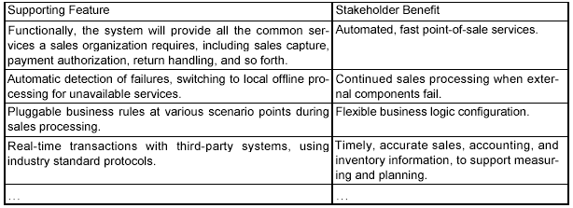
Summary of Benefits
Assumptions and Dependencies...
Cost and Pricing... Licensing and
Installation...

Slide 11
Summary of System Features
. sales capture
. payment authorization (credit, debit, check)
. system administration for users, security, code and constants tables, and so forth.
. automatic offline sales processing when external components fail
. real-time transactions, based on industry standards, with third-party systems, including inventory, accounting, human resources, tax calculators, and payment authorization services
. definition and execution of customized "pluggable" business rules at fixed, common points in the processing scenarios
.
Other Requirements and Constraints
Including design constraints, usability, reliability, performance, supportability, design constraints, documentation, packaging, and so forth: See the Supplementary Specification and use cases.

Slide 12
Vision, Features, or Use Cases.Which First
1. Write a brief first draft of the Vision.
2. Identify user goals and the supporting use cases.
3. Write some use cases and start the Supplementary Specification.
4. Refine the Vision, summarizing information from these

Slide 13
What Happened in Inception
. a short requirements workshop
. most actors, goals, and use cases named
. most use cases written in brief format; 10-20% of the use cases are written
in fully dressed detail to improve understanding of the scope and complexity
. most influential and risky quality requirements identified
. version one of the Vision and Supplementary Specification written
. risk list
For example, leadership really wants a demo at the POSWorld
trade show in Hamburg, in 18 months. But the effort for a demo
cannot yet be even roughly estimated until deeper investigation.
. technical proof-of-concept prototypes and other investigations to explore the
technical feasibility of special requirements ("Does Java Swing work properly
on touch-screen displays?")
. user interface-oriented prototypes to clarify the vision of functional
requirements

Slide 14
What Happened in Inception...
. recommendations on what components to buy/build/reuse, to be refined in
elaboration
For example, a recommendation to buy a tax calculation
package.
. high-level candidate architecture and components proposed
This is not a detailed architectural description, and it is not meant
to be final or correct. Rather, it is brief speculation to use as a
starting point of investigation in elaboration. For example, "A Java
client-side application, no application server, Oracle for the data-
base, ..." In elaboration, it may be proven worthy, or discovered to
be a poor idea and rejected.
. plan for the first iteration
. candidate tools list

Slide 15
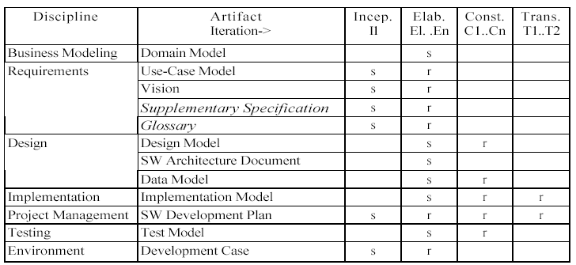

Slide 16
From Inception to Elaboration
Elaboration in one sentence:
Build the core architecture, resolve the high-risk elements, define most require-
ments, and estimate the overall schedule and resources.
Some key ideas and best practices that will manifest in elaboration include:
. do short timeboxed risk-driven iterations
. start programming early
. adaptively design, implement, and test the core and risky parts of the
architecture
. test early, often, realistically
. adapt based on feedback from tests, users, developers
. write most of the use cases and other requirements in detail, through a
series of workshops, once per elaboration iteration

Slide 17
What is Architecturally Significant in Elaboration
Early iterations build and prove the core architecture.
. Employing "wide and shallow" design and implementation; or "designing at
the seams" as Grady Booch has called it.
That is, identifying the separate processes, layers, packages, and
subsystems, and their high-level responsibilities and interfaces.
Partially implement these in order to connect them and clarify the
interfaces. Modules may contain mostly "stubbed" code.
. Refining the inter-module local and remote interfaces (this includes the finest
details of the parameters and return values).
For example, the interface to the object which will wrap access to
third-party accounting systems.
Version one of an interface is seldom perfect. Early attention to
stress testing, "breaking," and refining the interfaces supports
later multi-team parallel work relying on stable interfaces.

Slide 18
What is Architecturally Significant in Elaboration...
. Integrating existing components.
For example, a tax calculator.
. Implementing simplified end-to-end scenarios that force design, implementation, and test across many major components.
For example, the main success scenario of Process Sale, using the credit payment extension scenario.

Slide 19
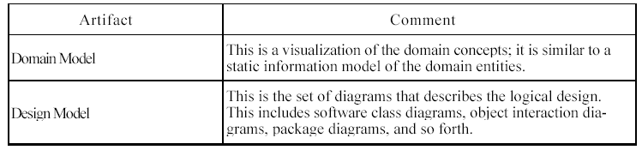
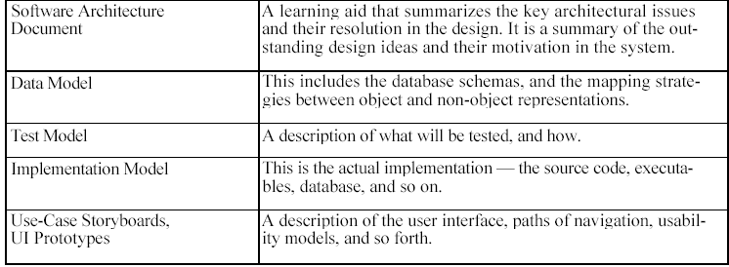
What Artifact May Start in Elaboration

Slide 20
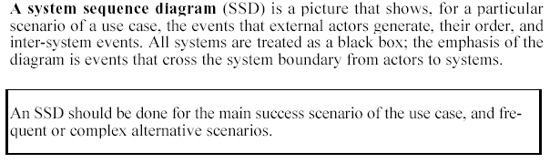
Use-Case Model: Drawing System Sequence Diagrams

Slide 21
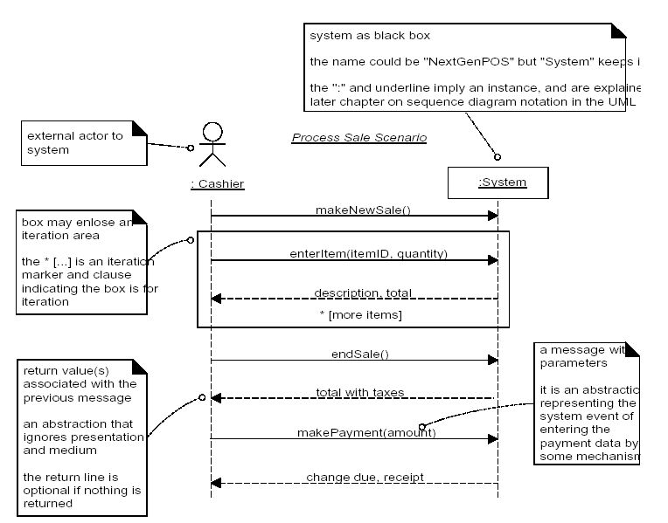
Example of an SSD

Slide 22
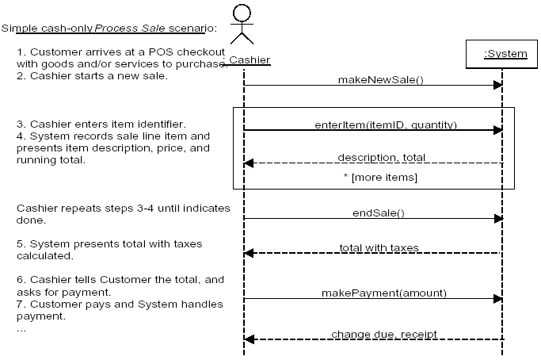
SSDs and Use Cases

Slide 23
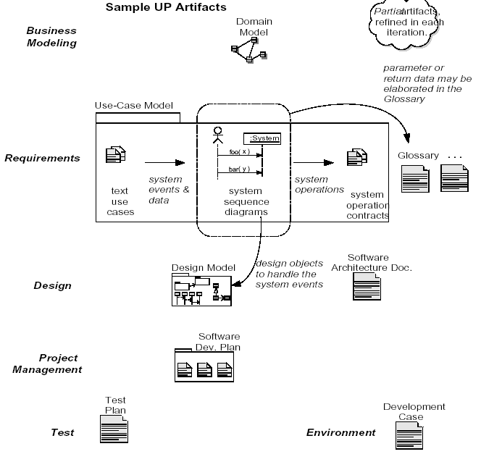

Slide 24
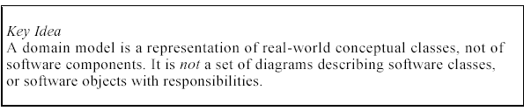
Domain Model: Visualizing Concepts
A domain model is a visual representation of conceptual classes or real-world objects in a domain of interest.
Using UML notation, a domain model is illustrated with a set of class diagrams in which no operations are defined. It may show:
• domain objects or conceptual classes
• associations between conceptual classes
• attributes of conceptual classes

Slide 25
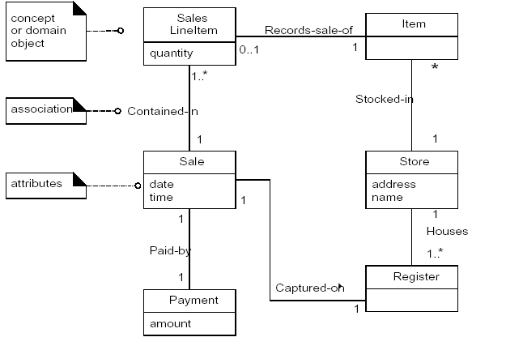

Slide 26
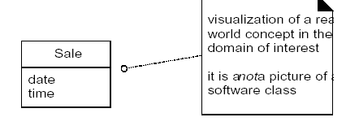
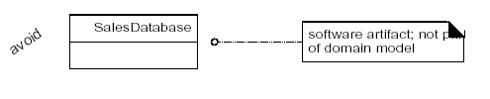
Domain Models are not Models of Software Components
The following elements are not suitable in a domain model:
• Software artifacts, such as a window or a database, unless the domain being
modeled is of software concepts, such as a model of graphical user interfaces.
• Responsibilities or methods.4

Slide 27
Conceptual Class Identification
A central distinction between object-oriented and structured analysis is: divi-
sion by conceptual classes (objects) rather than division by functions.
Therefore, a primary analysis task is to identify different concepts in the prob-
lem domain and document the results in a domain model.
Two techniques are presented to identify conceptual classes:
1. Use a conceptual class category list.
2. Identify noun phrases.

Slide 28
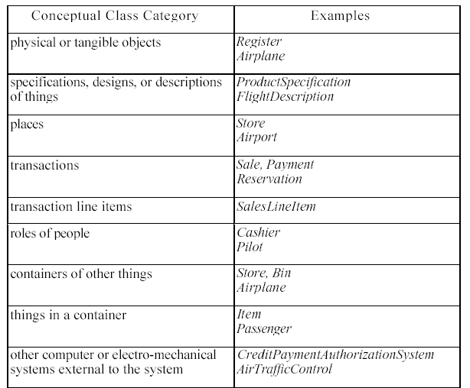
Conceptual Class Category List

Slide 29
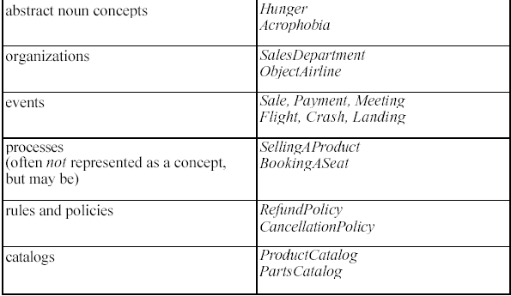
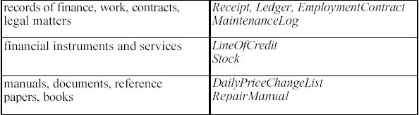
Conceptual Class Category List...

Slide 30
Finding Conceptual Classes with Noun Phrase Identification
Another useful technique (because of its simplicity) suggested in [Abbot83] is
linguistic analysis: identify the nouns and noun phrases in textual descriptions
of a domain, and consider them as candidate conceptual classes or attributes.

Slide 31
Finding Conceptual Classes with Noun Phrase Identification...
Main Success Scenario (or Basic Flow):
1. Customer arrives at a POS checkout with goods and/or services to purchase.
2. Cashier starts a new sale.
3. Cashier enters item identifier.
4. System records sale line item and presents item description, price, and runningtotal. Price calculated from a set of price rules.
Cashier repeats steps 2-3 until indicates done.
5. System presents total with taxes calculated.
6. Cashier tells Customer the total, and asks for payment.
7. Customer pays and System handles payment.
8. System logs the completed sale and sends sale and payment information to the external Accounting (for accounting and commissions) and Inventory systems (toupdate inventory).
9. System presents receipt tendered.
.....

Slide 32
Domain Modelling Guidelines
Apply the following steps to create a domain model:
1. List the candidate conceptual classes using the Conceptual Class Cate-
gory List and noun phrase identification techniques related to the current
requirements under consideration.
2. Draw them in a domain model.
3. Add the associations necessary to record relationships for which there is a
need to preserve some memory (discussed in a subsequent chapter).
4. Add the attributes necessary to fulfill the information requirements (dis-
cussed in a subsequent chapter).

Slide 33
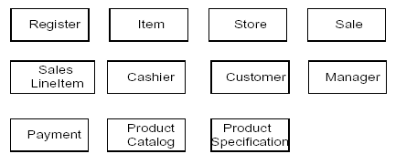
Example: The NextGen POS Domain Model

Slide 34
